Slide 1
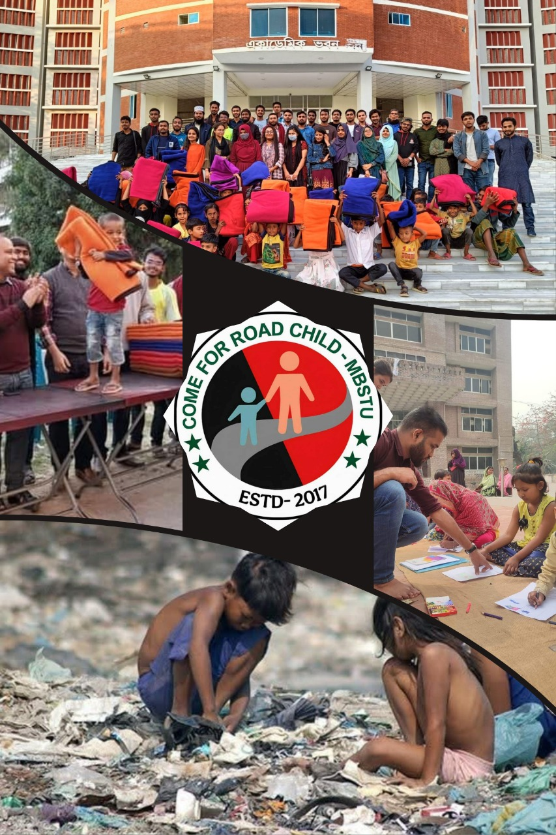
CRC-MBSTU and the SDGs: Working for a Sustainable Future
Come for Road Child, Mawlana Bhashani Science and Technology University

Slide 2
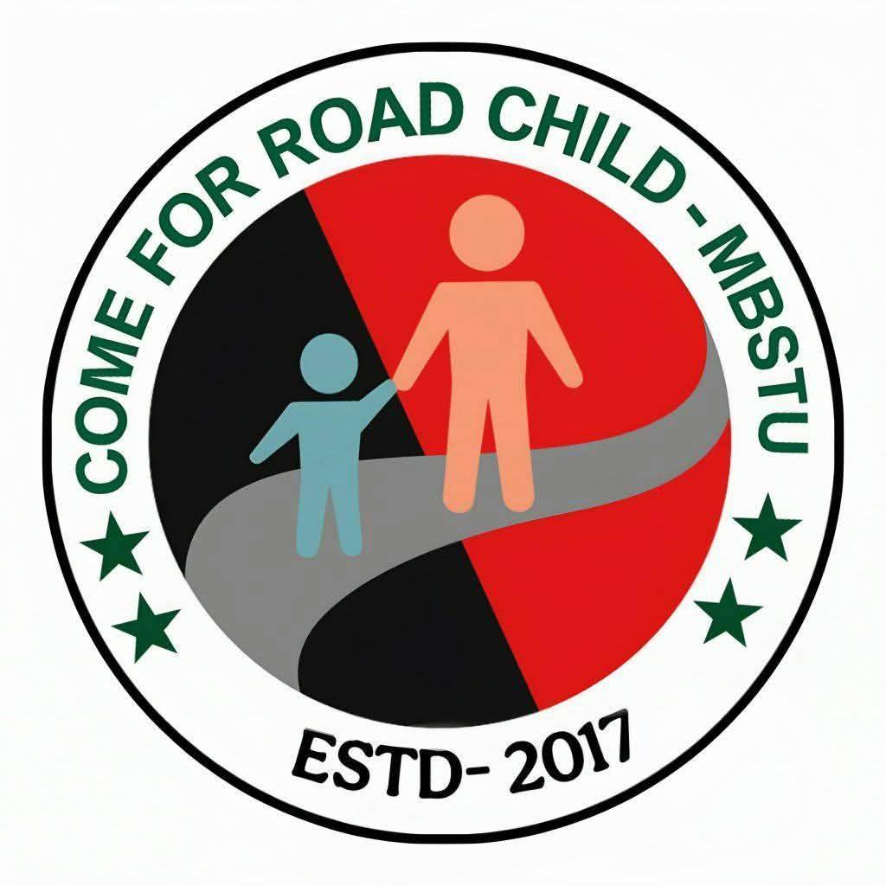

Introducing Come for Road Child (CRC-MBSTU)
Voluntary Student Organisation
Core Mission
Dedicated to supporting underprivileged and street children in the local community.
A dynamic, student-led initiative based at Mawlana Bhashani Science and Technology University (MBSTU).
Our Pillars
Focusing on holistic support through education, healthcare access, and social awareness programmes.

Slide 3

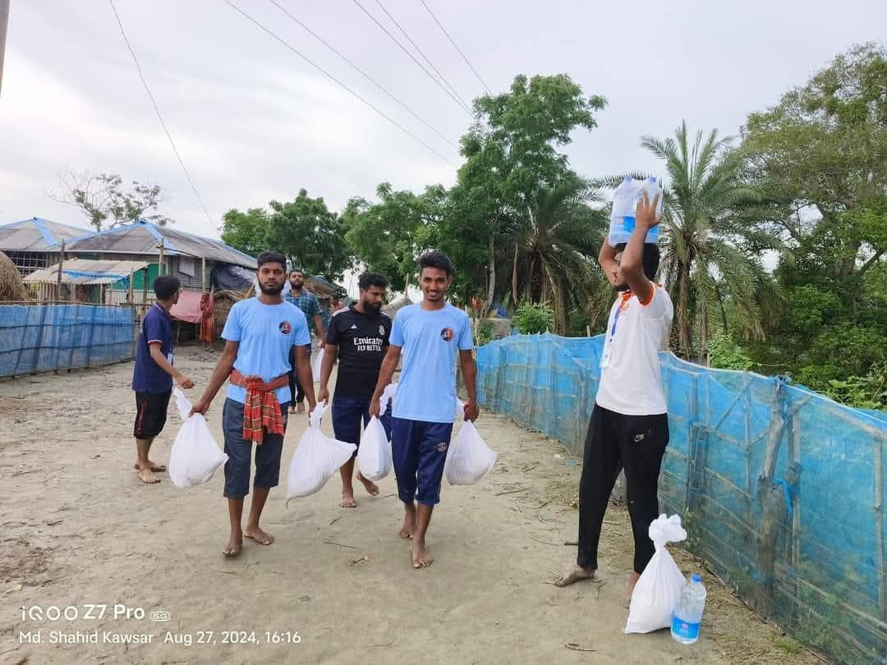
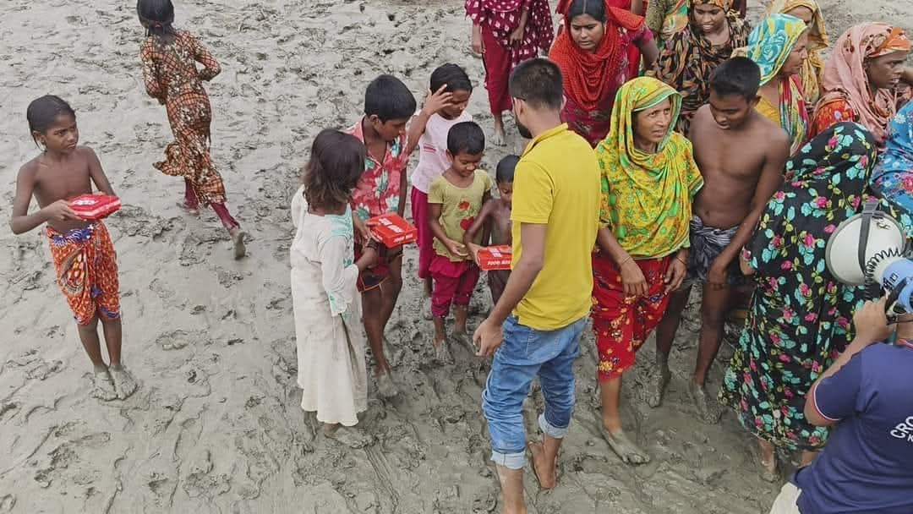
CRC-MBSTU’s Direct Alignment with Global Goals
CRC's voluntary efforts directly address six critical SDGs, demonstrating the power of youth-led local action to achieve global impact.
SDG 1: No Poverty
Providing essential food aid and financial support to lift vulnerable children out of extreme poverty.

Slide 4
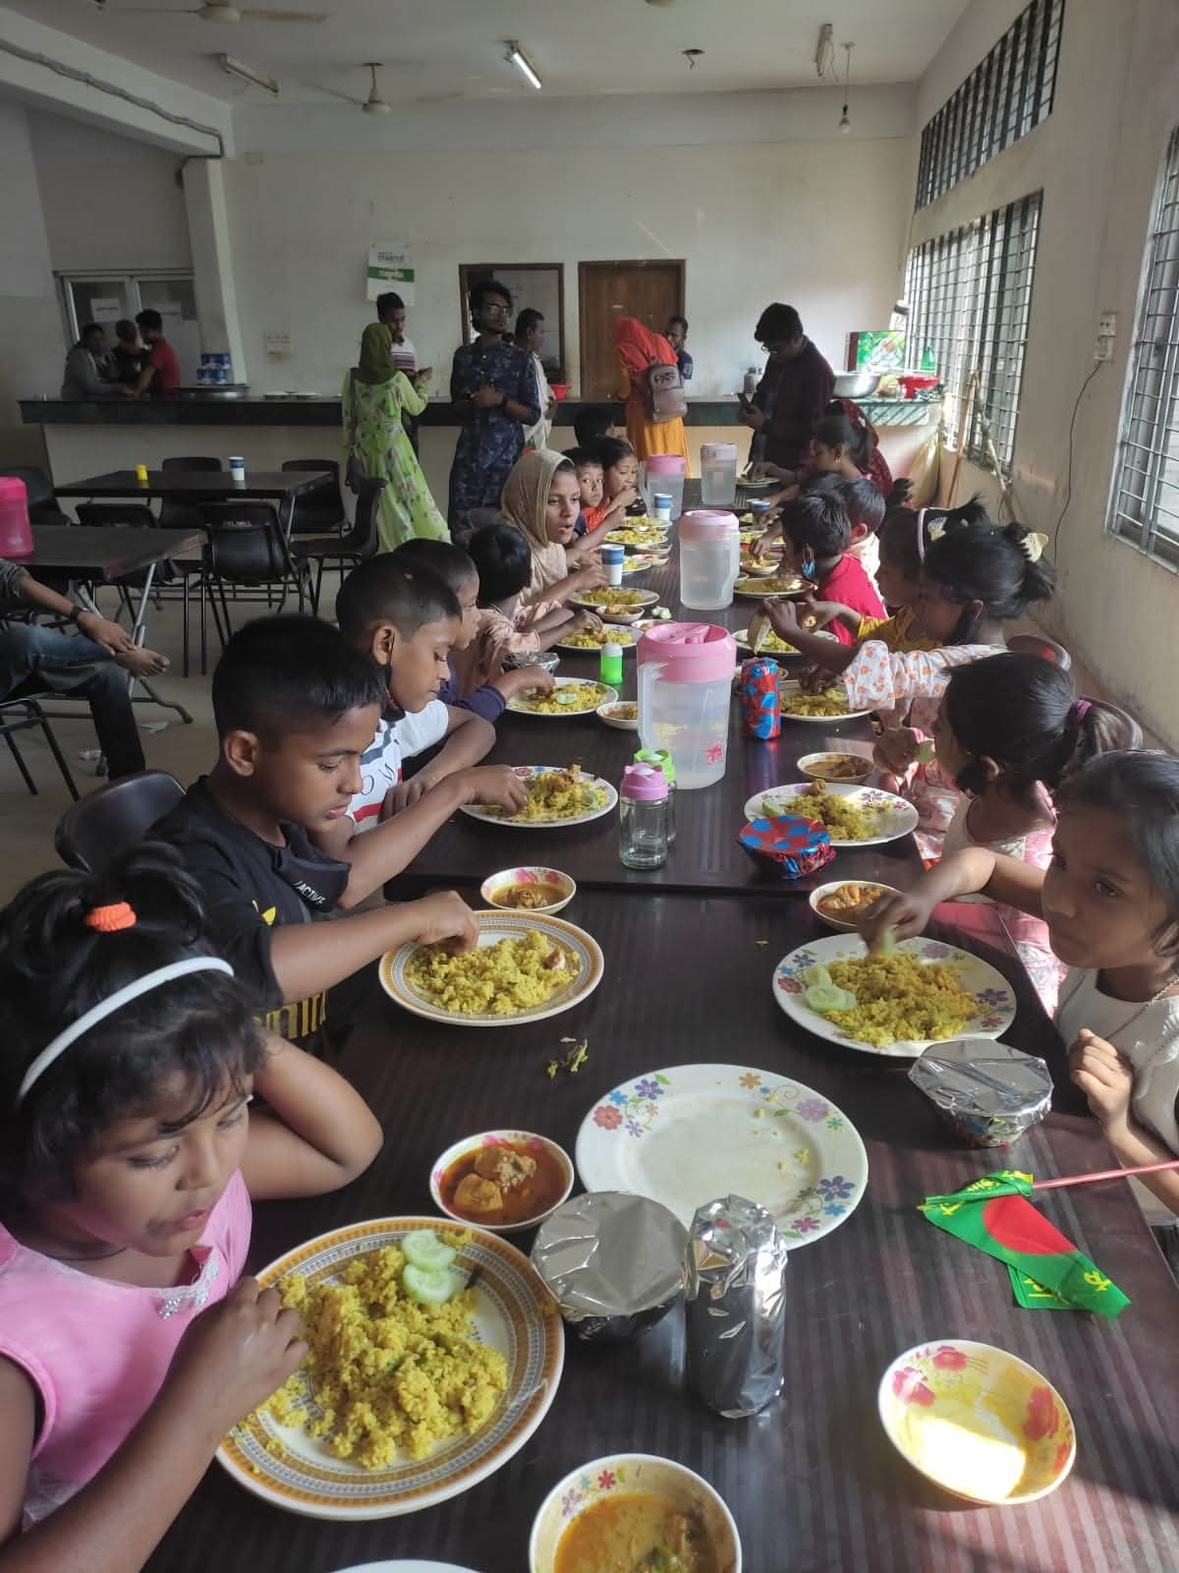
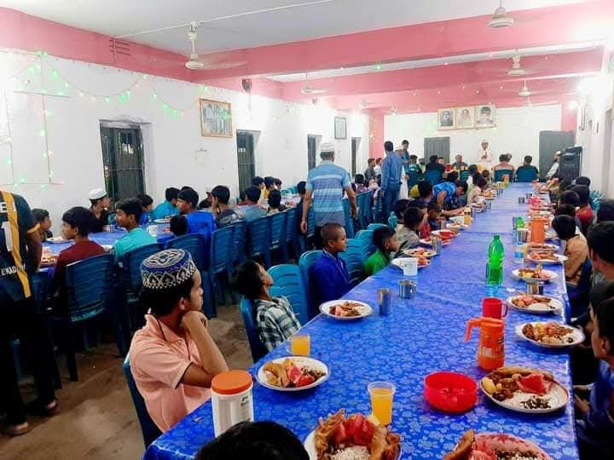
CRC-MBSTU’s Direct Alignment with Global Goals
CRC's voluntary efforts directly address some critical SDGs, demonstrating the power of youth-led local action to achieve global impact.
SDG 2: Zero hunger
The club often arranges food distribution programs for street and needy children to ensure basic nutrition

Slide 5
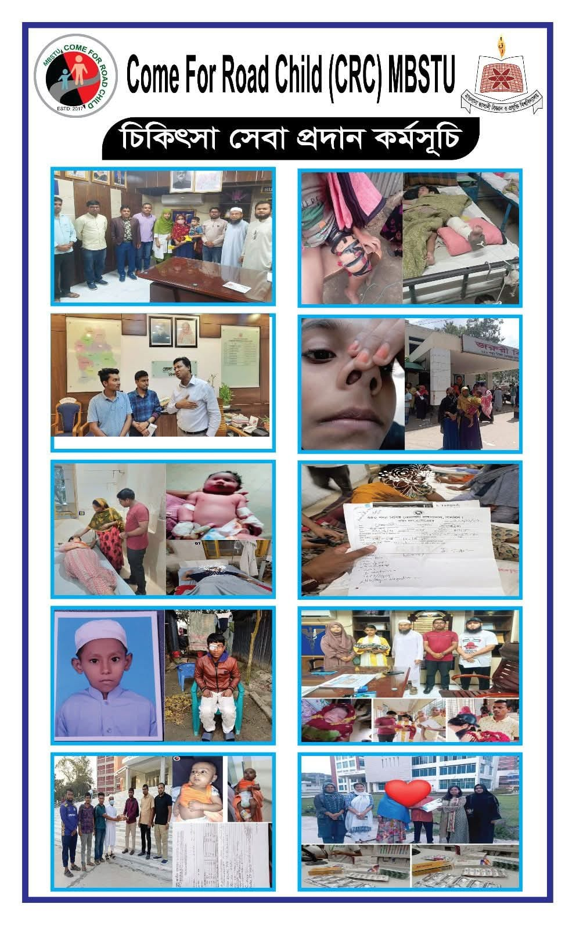

CRC-MBSTU’s Direct Alignment with Global Goals
CRC's voluntary efforts directly address some critical SDGs, demonstrating the power of youth-led local action to achieve global impact.
SDG 3: Good Health
Organising health camps, offering essential first aid training, and facilitating medical support for street children.

Slide 6

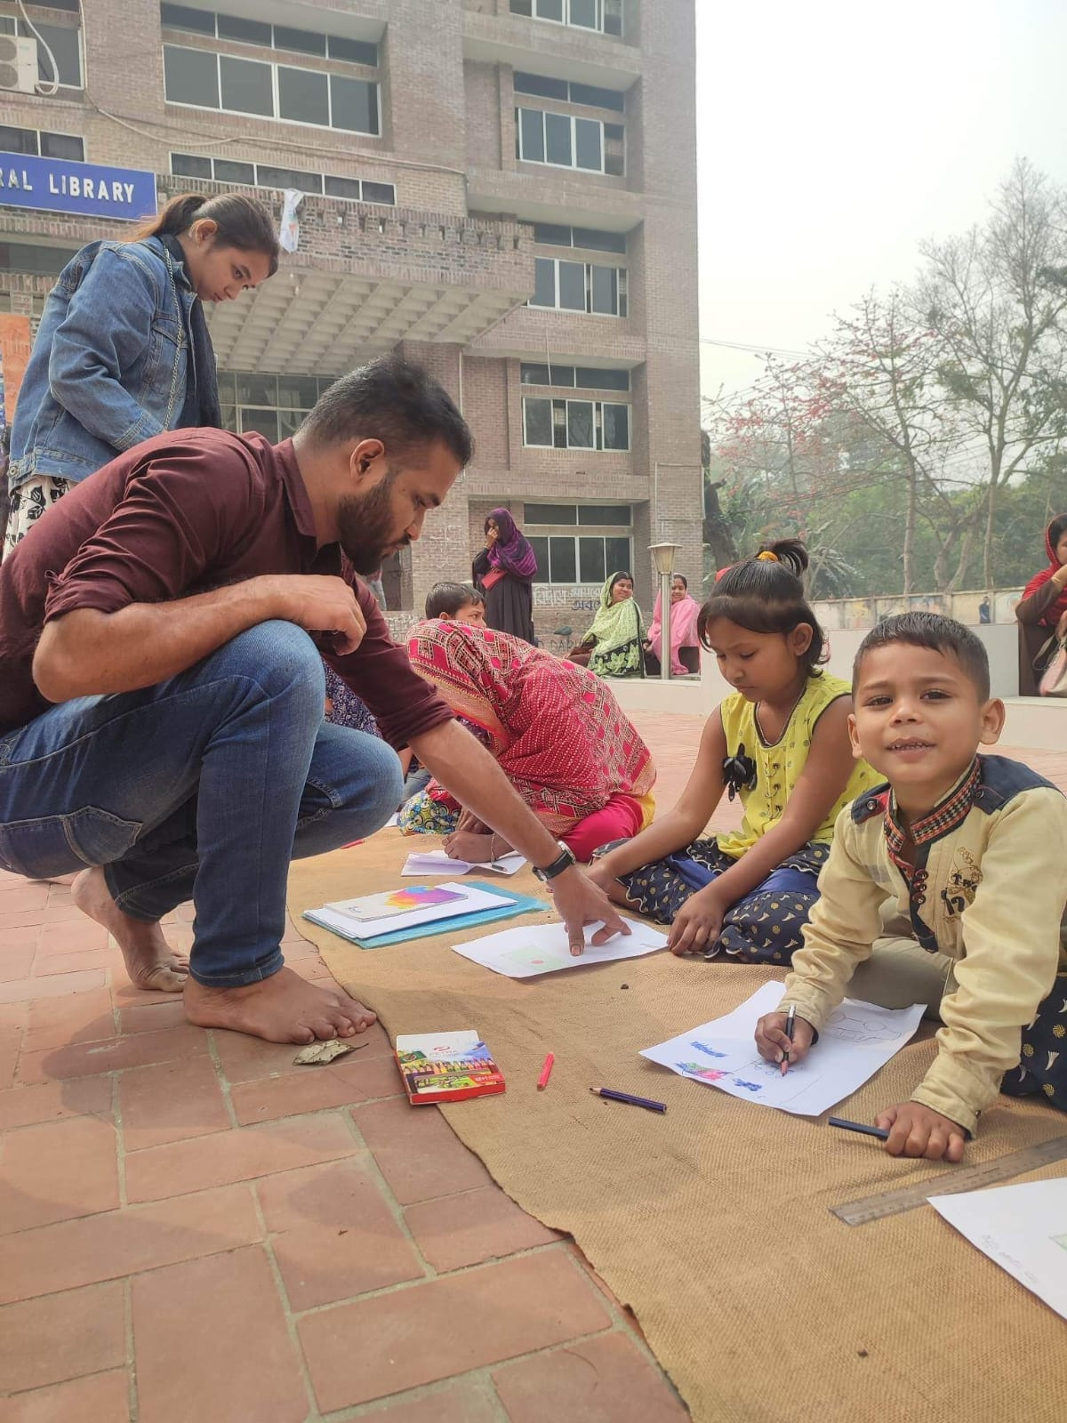
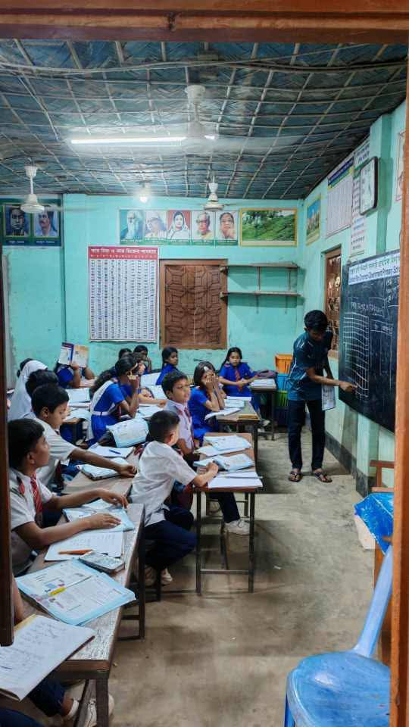
CRC-MBSTU’s Direct Alignment with Global Goals
CRC's voluntary efforts directly address some critical SDGs, demonstrating the power of youth-led local action to achieve global impact.
SDG 4: Quality Education
Conducting free, structured teaching sessions and donation drives for books and stationery.

Slide 7

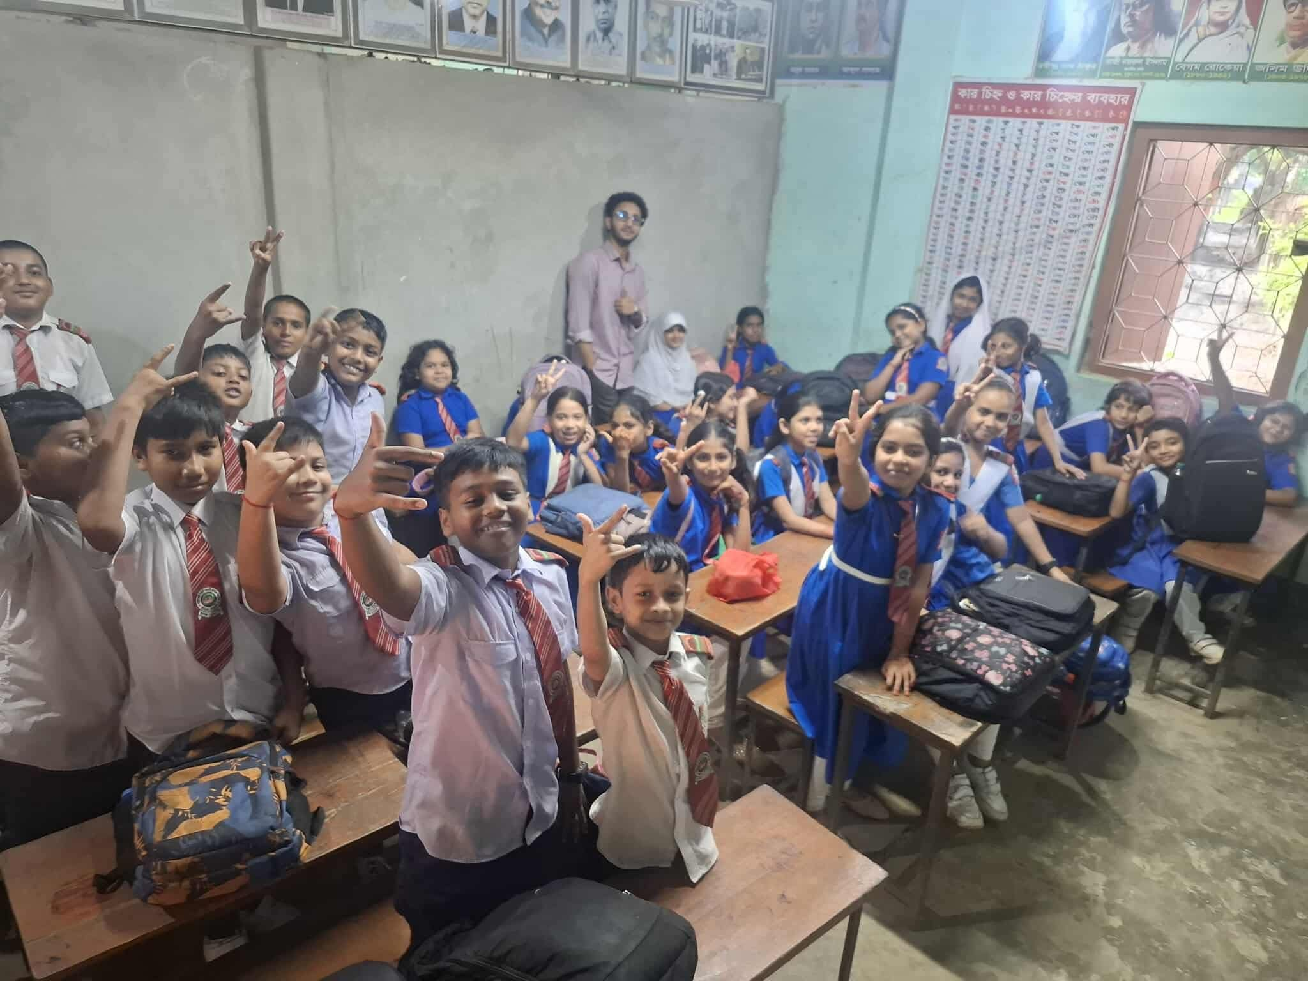
CRC-MBSTU’s Direct Alignment with Global Goals
CRC's voluntary efforts directly address some critical SDGs, demonstrating the power of youth-led local action to achieve global impact.
SDG 5: Gender Equality
Promoting equal access to education for both boys and girls, and ensuring gender balance among volunteers.

Slide 8


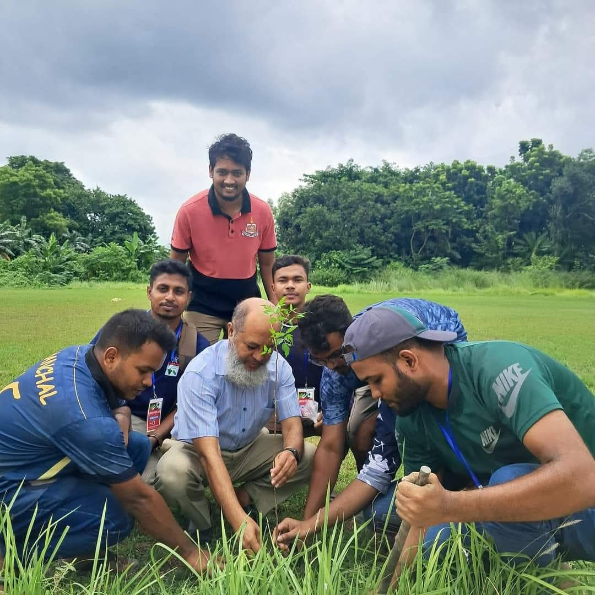
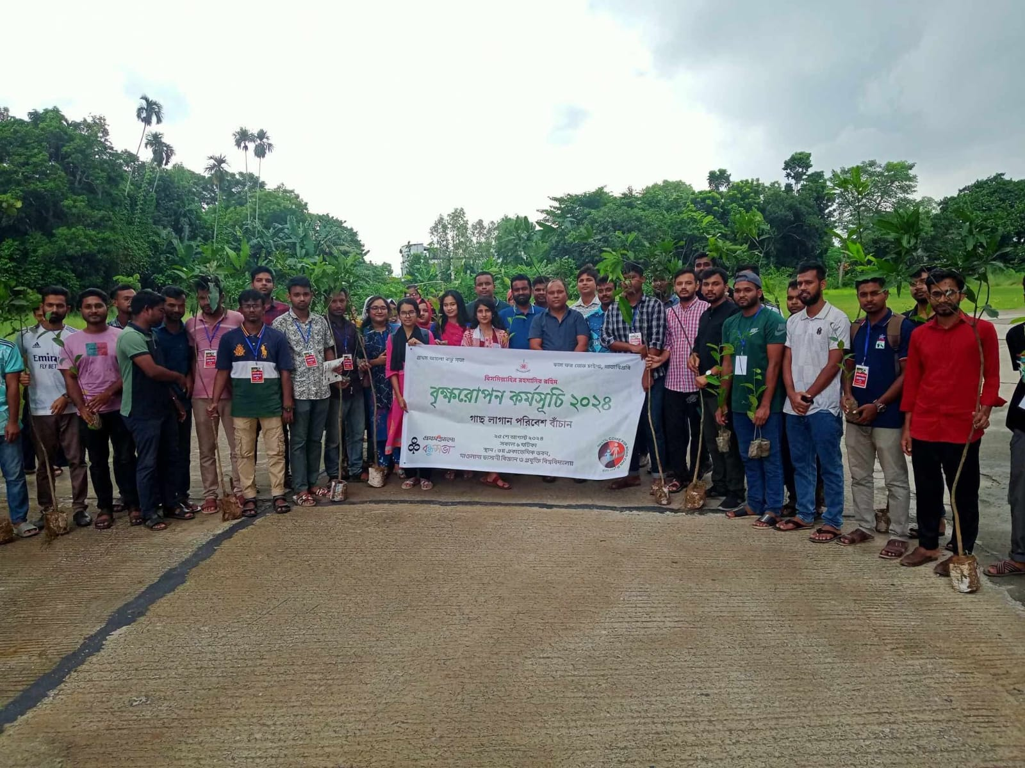
CRC-MBSTU’s Direct Alignment with Global Goals
CRC's voluntary efforts directly address some critical SDGs, demonstrating the power of youth-led local action to achieve global impact.
SDG 11 – Sustainable Cities and Communities
SDG 15 – Life on Land
CRC’s plantation drives make the MBSTU campus and nearby areas greener, cleaner, and more livable
By planting trees, CRC contributes to protecting terrestrial ecosystems, preventing soil erosion, and preserving biodiversity.
SDG 13 – Climate Action
CRC organizes tree plantation programs to combat climate change and reduce global warming.

Slide 9

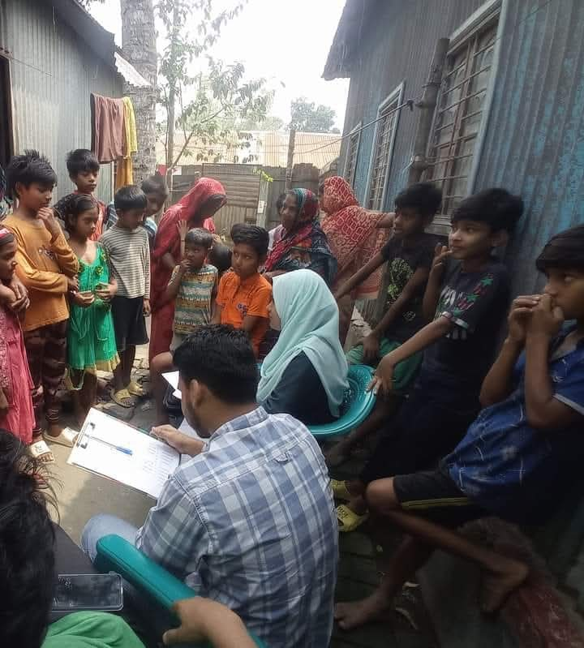
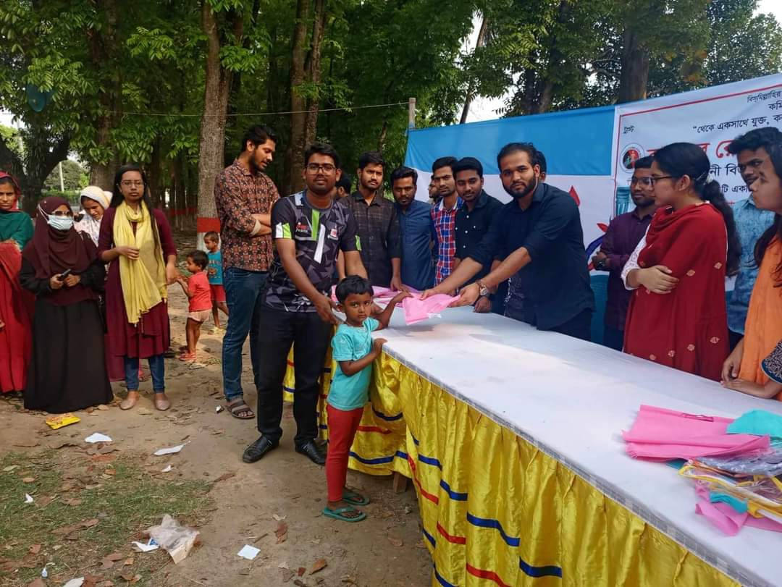
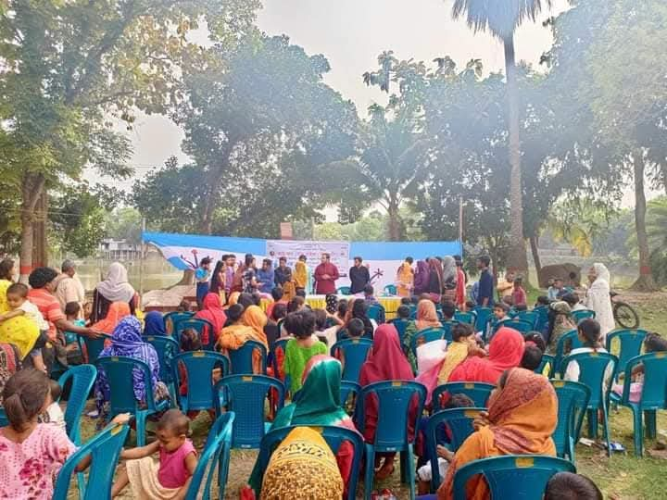
CRC-MBSTU’s Direct Alignment with Global Goals
CRC's voluntary efforts directly address six critical SDGs, demonstrating the power of youth-led local action to achieve global impact.
SDG 10: Reduced Inequalities
Working proactively to integrate marginalised children into mainstream social opportunities and awareness.

Slide 10
Focus on Education: The Foundation of Empowerment (SDG 4)
Free Teaching Programmes
Regular, structured classes held in accessible community spaces.
Curriculum focused on foundational literacy, numeracy, and life skills.
Creating a safe and engaging learning environment away from the street.
CRC volunteers believe that education is the most powerful tool for ending the cycle of poverty.

Slide 11
Health and Well-being Initiatives (SDG 3)
Beyond education, CRC addresses the critical health disparities faced by underprivileged children.
Community Health Campaigns
First Aid Training
Equipping volunteers and older children with basic first aid knowledge for immediate response.
Organising free medical check-ups and distributing essential medicines and hygiene kits.
Nutritional Support
Targeted provision of nutritious meals and supplements to address chronic malnutrition.

Slide 12
Impact in Numbers: Stories of Change
300+
100+
10
Children Benefited
Volunteers Engaged
Major Events
Directly benefiting from regular education and health support programmes each year.
Active student volunteers from various departments across MBSTU.
Organised large-scale health camps, book drives, and awareness programs annually.
"Seeing a child who used to spend their day begging now eagerly holding a textbook—that is our measure of success."

